Slide 1
COMPILER CONSTRUCTION PROJECT GROUP MEMBERS: UMNA ALEEM SIDRA SAEED

Slide 2
LANGUAGE SELECTION
MINI C
MiniC is a simple subset of the standard C language. It does not include arrays, structs, unions, files, sets, switch statements, do statements, or many of the low level operators. The only data types permitted are int and float.

Slide 3
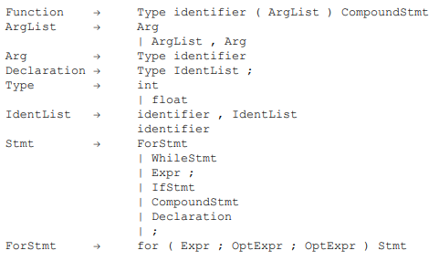
LEXICAL SPECIFICATION

Slide 4
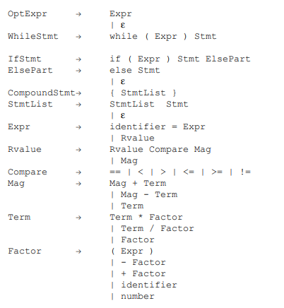

Slide 5
CONTEXT FREE GRAMMER

